Slide 1
Advocacy Agenda for PrEP in Trials and SRHR Services?
Manju Chatani-Gada
AIDS2018, July 2018

Slide 3
Advocates engaged in this discussion…
Trial participants have the right to the highest standard of HIV prevention and care as part of participation
WHO/UNAIDS ethics guidance
UNAIDS/AVAC Good Participatory Practice Guidelines for biomedical HIV prevention
But ethics, trial design issues, resources complex - opinions differ and politics abound
Advocates been engaged in this discussion as long as they have been engaged in rx discussions
Standard of treatment, ..of prevention, post-trial access
Variety of ways oral PrEP provided, e.g. ECHO, MTN trials

Slide 4
https://www.avac.org/sites/default/files/u3/Advocates_Imbizo_Statement.pdf

Slide 5
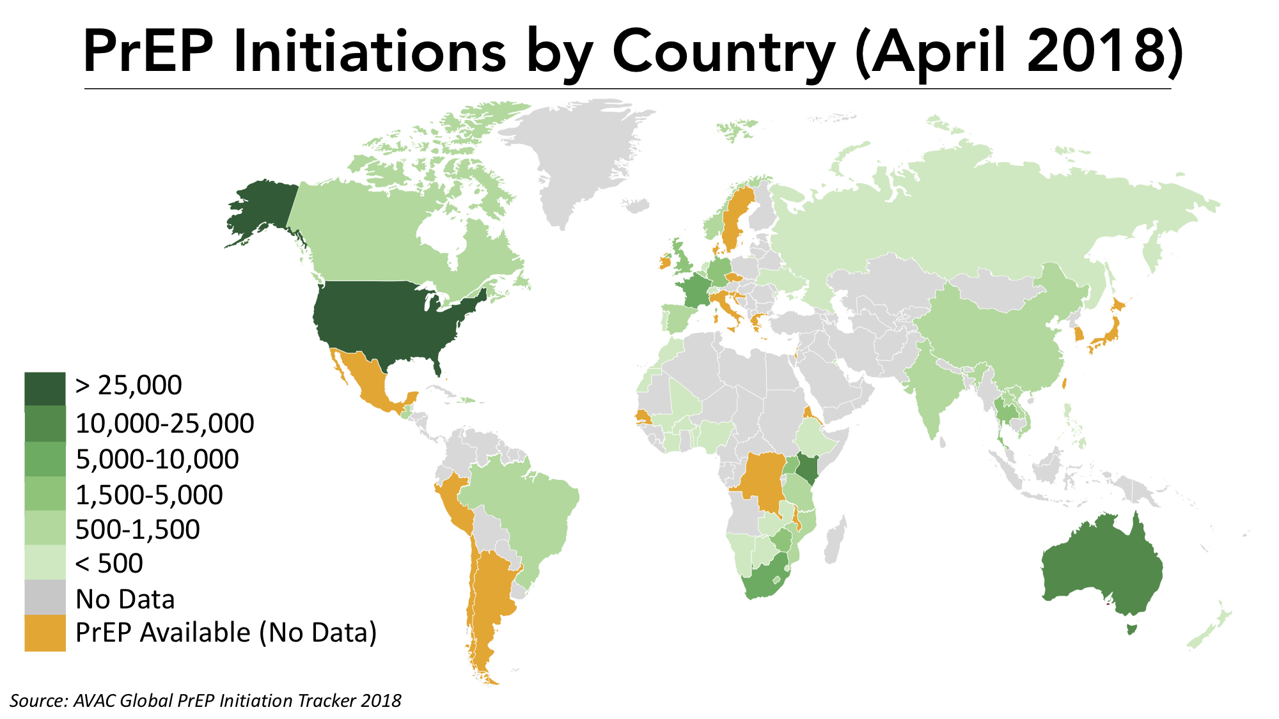
www.avac.org

Slide 6
Never be less PrEP…
While one research organization, product developer or funder cannot reverse global inequities in HIV prevention or care, researchers have an obligation—and an opportunity—to try to narrow the equity gap.
Never be fewer countries offering oral PrEP
If not now, then by the time the study ends
Trial participants come from the same communities that most need prevention options
Research design needs to prepare for future context, not current one

Slide 7
Moving forward…
Civil society is key to the HIV response and must be engaged/involved
Context matters: trial sites & govts engage with the changing environment
Innovative access to PrEP in trials
Inclusive engagement of community-based advocates and CABs
Regulators, ethics review bodies and funders need to be coordinated across geographies and networks.

Slide 8
PrEP as part of SRH services?
Yes of course! But…

Slide 9
Key Questions about Users (& Influencers)
Personal
Programmatic
Policy
Who needs what?
Who wants what?
Who gets what?
How to deliver it?
How to support adherence?
Who pays?
Who decides?
Those who use
Those who choose
Those who pay the dues

Slide 10
“Women’s needs are much more complex than just HIV, access to PrEP only will not solve all other needs like avoiding pregnancies and STIs, hence access to the other services remains key.”
“Integrating PrEP with SRH services would help complement other already existing efforts with similar intentions. In addition to condoms some SRH sites are already offering additional HIV prevention services like VMMC. Bringing in PrEP would help make the services more comprehensive”
“Often times when we talk about SRH what comes to mind is a woman, yet men are also supposed to be given access to SRH. With Integrating PrEP in SRH clinics two things could happen; it would either result in low uptake of PrEP among men, or it could attract more men to come to the SRH clinic thereby increasing their uptake of the other SRH services”
“Right now, PrEP is still in its pilot phase in Western Cape, so it is hard for me to foresee this type of implementation and distribution”

Slide 11
Yes….
“Everyone I know who takes PrEP also uses family planning…”
“…accessing various services from different service points can be boring”
Women accessing SRH have health seeking behavior; already talking to HCW about unprotected sex; understand cycling on/off
PrEP and contraception timing/tests could be aligned
Clinic/mobile/center doing something right
Start building out delivery platform for future MPTs
PrEP works, provides choice, “Can be used covertly (sort of)”
Could help in destigmatizing PrEP as part of a broader package
This is may be the best entry point even if uptake is initially low

Slide 12
But…
“Some girls felt that once their partner finds out they’re on PrEP they’ll stop using condoms”
Is contraception-seeking same as HIV px seeking? Or pill seeking?
FP funding bring women to clinics for FP services, not for oral PrEP
PrEP is new: more myths, stigma – could it hurt FP services?
Do those who most need PrEP access SRH or other services?
SRH basically (overburdened) primary health care services
Integration not widespread (few offer HIV testing, mostly referrals)
Poor choice and info of existing contraceptive options
Confusion of PEP and PrEP
Self-testing in PHC makes risk assessment counseling challenging

Slide 13
ACCESS POINT AND MAIN METHOD FOR YOUTH
Married
Public Facility
Bangladesh
India
Myanmar
Burkina
DRC
Nigeria
Uganda
Private Facility
Pharmacy/Shop
Unmarried
Friend/Relative
Source: Beth Schlacter, FP2020 – AIDS2018

Slide 14
But…
“We haven’t figured out how to do it well enough yet – so this is not the model we want to integrate. We have to tweak it more”
Do we want to focus limited resources on one model of delivery?
SRH access points - implementation studies or very small rollout
PrEP uptake as part of SRH (FP) still not optimal: low uptake & return
Community based SRH services severely compromised by resource cuts (such as Global Gag rule) –existing SRH stretched very thin
“It’s just the two of us providing support to GBV victims and now we have to talk to them about PrEP as well”
Provider stigma could be a big barrier

Slide 15
Sanyukta Mathur, Population Council, AIDS2018 – PEPFAR DREAMS

Slide 16
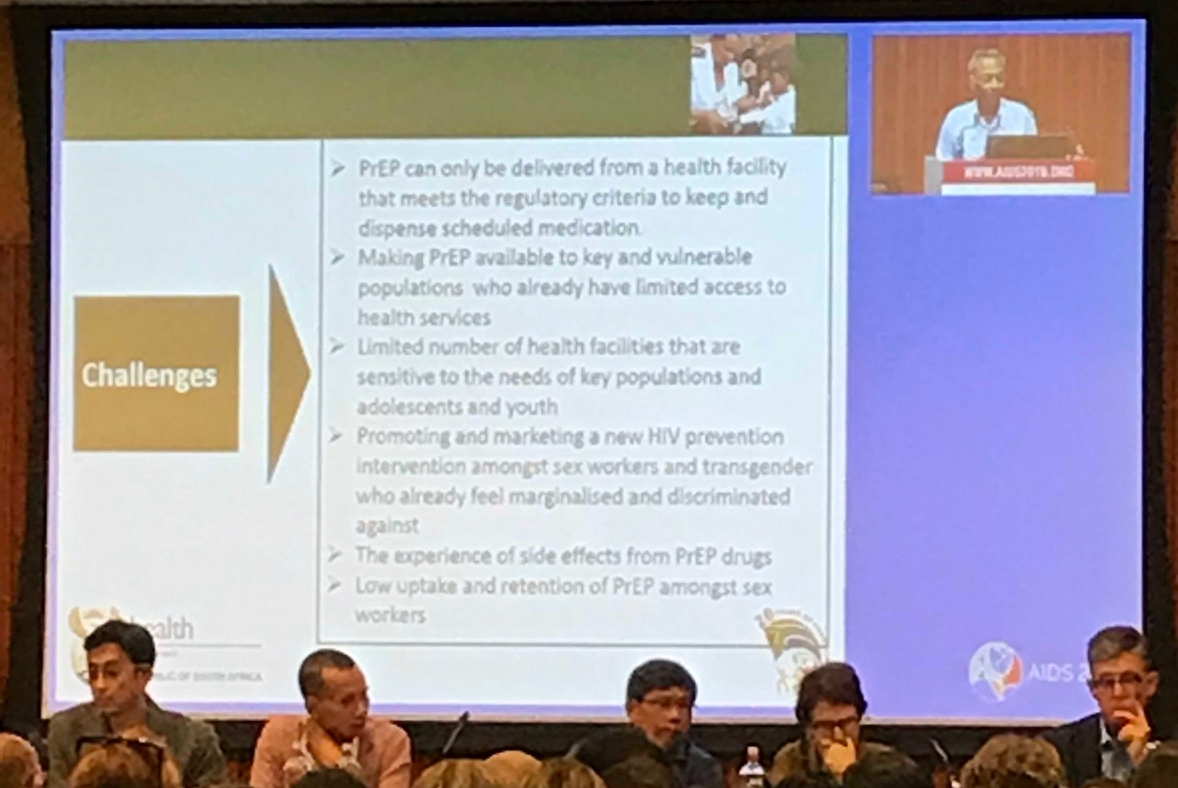
Yogan Pillay, AIDS2018

Slide 17
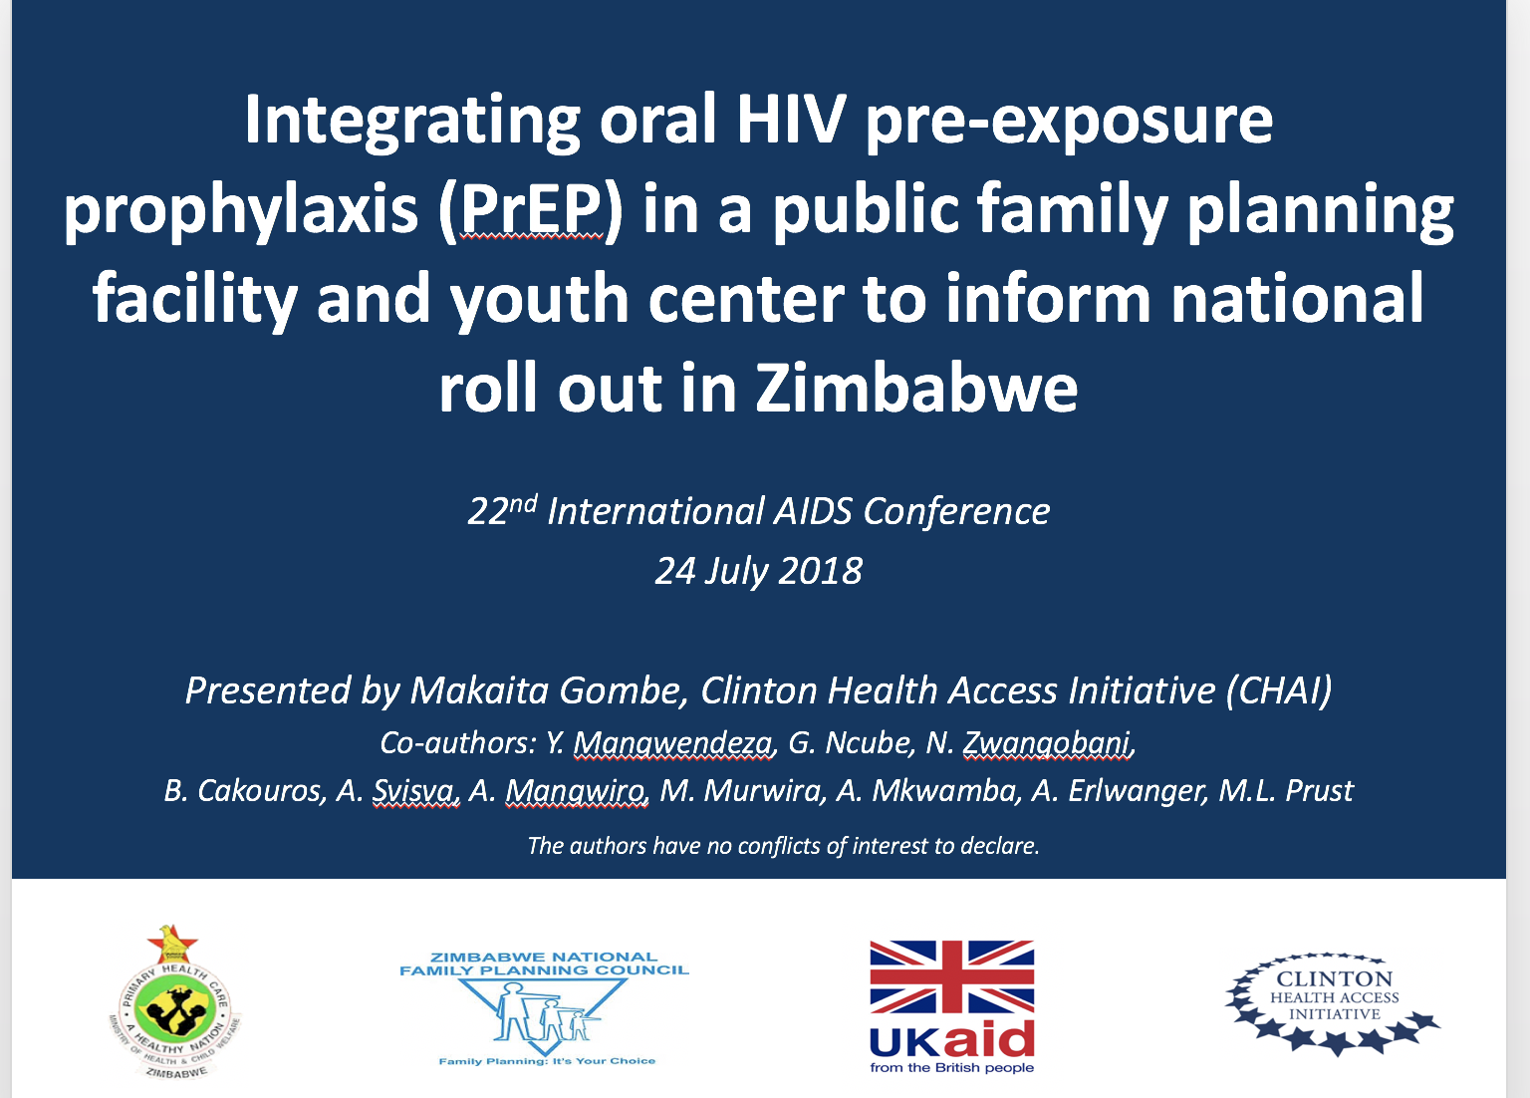
Sanyukta Mathur, Population Council, AIDS2018 – PEPFAR DREAMS

Slide 18
And what about?
New formulations of PreP?
If there is a backlash to PreP?
If HCW training not updated adequately?
Few resources added?
Managing sero-conversion, testing, lab tests, side-effects?
HIV-services have more funding (at the moment)
What about the men? What about other KPs?
Those who don’t access SRH - or any services?

Slide 19
Advocacy: aspirational to realistic…
It’s early days: don’t let early teething problems dissuade us
Contextual: many points of delivery and focused on where the populations that need them access
Integrating advocacy: integrating HIV and SRH services (even without PrEP) critical - but even our advocacy is not fully integrated yet
Looking to the future and preparing for MPTs
“Every service as an entry point for every other service”

Slide 20
Advocacy: aspirational to realistic…
Need new models, many platforms & commitment to integration
Multiple delivery platforms (e.g. SRH services & PrEP access for men too)
Staff training: ARV provision, testing, side effects
Community adherence support
HTC services as part of the broader services
Linkage to care & treatment
Consider optimal and minimum requirements

Slide 21
Integration is critical!
Donors need to invest in innovating this model, research for better integrated delivery model
Integration index
Generation Now
Integration of PrEP (HIV services) is an opportunity to revitalize health systems
Investing in community support systems (not just community delivery mechanisms)

Slide 22
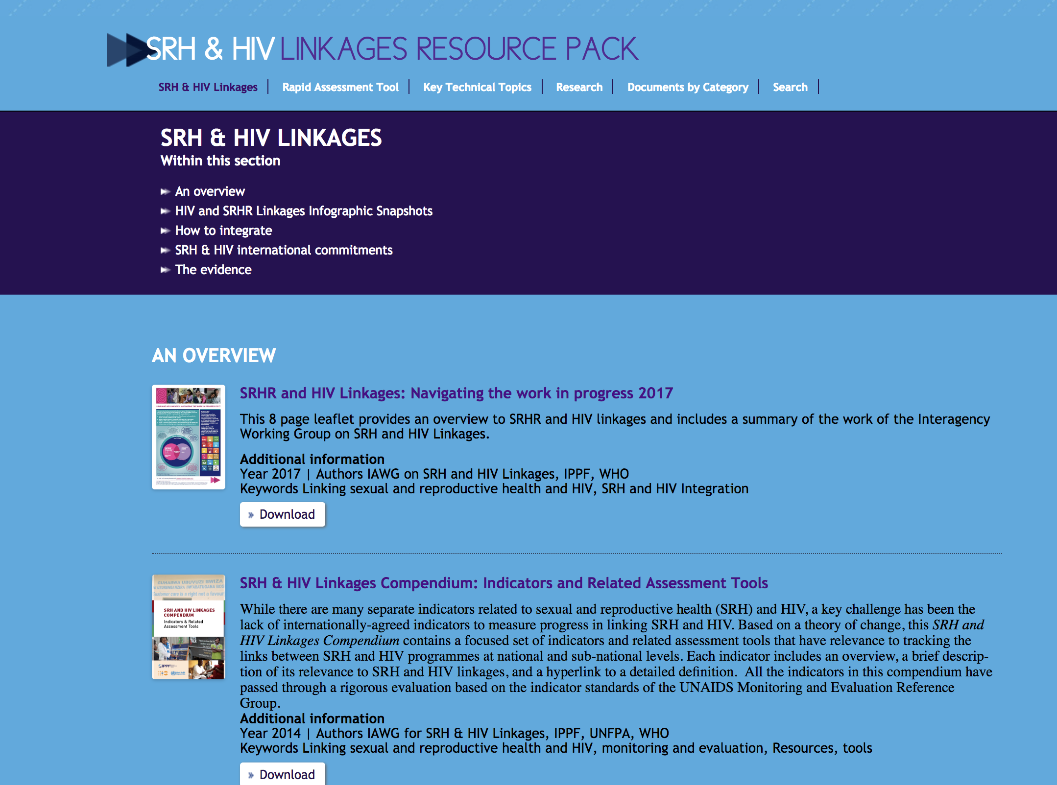
Great resources & initiatives to use and support!

Slide 23
“Not everyone is comfortable with the existing preventive options let alone being readily accessible to them. So it's necessary to ensure that we have multiple options along with the effort to make sure they are available and accessible to everyone.”
“Young girls need the resource of PrEP as part of Family Planning, and so if they can get it as part of that service, I think this is what our end goal should be.”

Slide 24
Many thanks to…
Georgina Caswell, Sinead Delaney, Emily Gwavava, Chilufya Hampongo, Letty, Maureen Luba, Imelda Mahaka, Deloune Matongo, Wanjiru Mukoma, Lillian Mwaykosi, Definate Nhamo, Neliswa Nkwali, VARG
Colleagues at AVAC
And to the integration advocates who tirelessly beat that drum…
www.avac.org

